Slide 1


Python Webapp Programming
HTTP, HTML and CSS

Slide 2
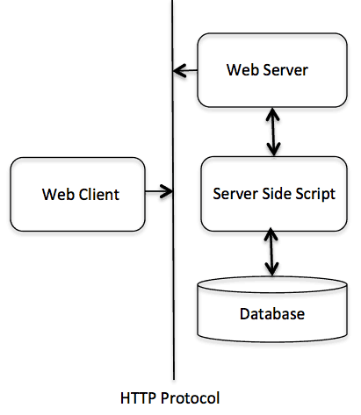
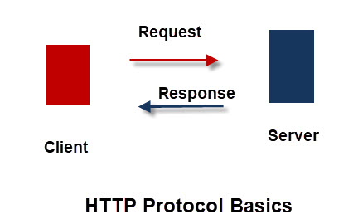
Http basics
A protocol between browser in your computer, and webserver in the cloud
The client makes a request, and the server responds
The HTTP protocol is also a stateless protocol meaning that the server isn’t required to store session information, and each request is independent of the other.
HTTP cookies allow the use of stateful sessions. Using header extensibility, HTTP Cookies are added to the workflow, allowing session creation on each HTTP request to share the same context, or the same state.

Slide 3
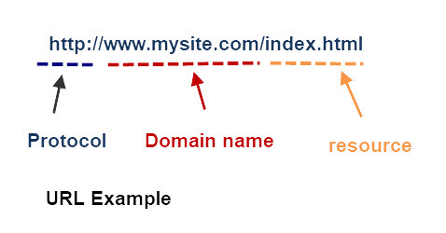
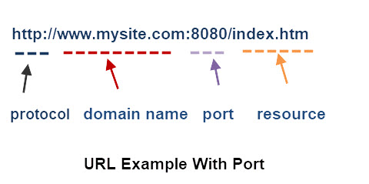
URL
URL (uniform resource Locator) is used for web pages.
We only see the URL at the browser address bar. The actual http request is not shown by the browser.
Protocol are also sometimes called ‘scheme’
Domain name sometimes also called ‘site’ or ‘address’ or ‘hostname’
Resource are sometimes also called ‘path’.

Slide 4
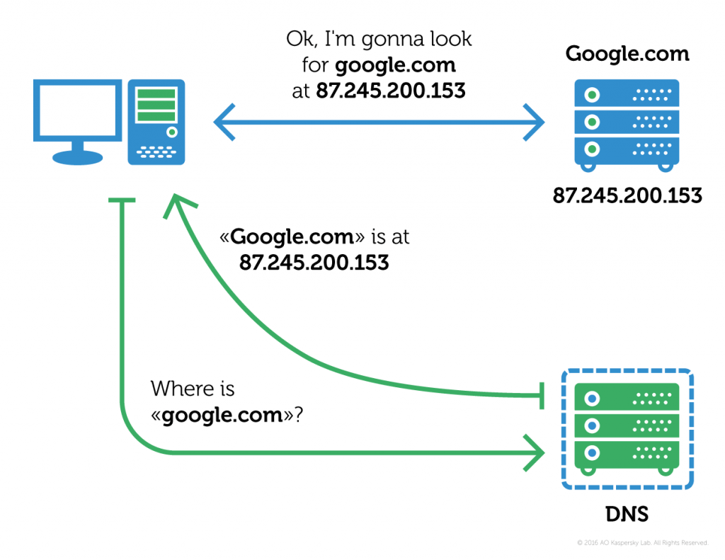
DNS
Before you can use your favorite browser to find any contents from the server, you need to know that on the back, the browser need to find out the address of the server first.
This was done using DNS. (Domain Name Service)

Slide 5
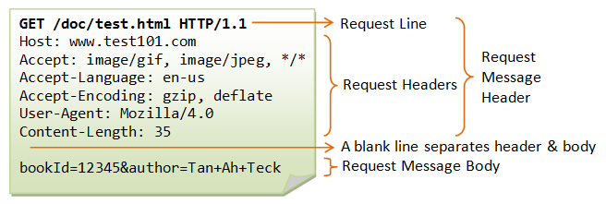
Request
A request consists of:
Request line with: method, path, protocol
+ optional headers (as Name:Value pairs)
+ optional body content.

Slide 6
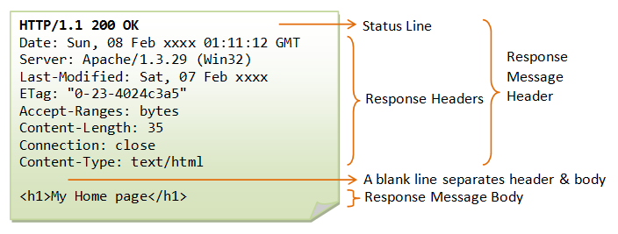
response
A response consists of:
Status line with: protocol, status code
+ optional headers (as Name:Value pairs)
+ optional body content.

Slide 7
More on request and response
Request Types
GET - Requesting resource from server
POST - submitting a resource to a server (e.g. file uploads)
PUT - As POST but replaces a resource
DELETE - Delete a resource from a server
HEAD - As GET but only return headers and not content
OPTIONS - Get the options for the resource
PATCH - Apply modifications to a resource
TRACE - Performs message loop-back
Response Status codes are split into 5 groups each group has a meaning and a three digit code.
1xx – Informational
2xx – Successful
3xx – Multiple Choice
4xx – Client Error
5xx – Server Error
Create
Read
Update
Delete

Slide 8
Response contents
HTTP support lots of content-types. Here is a list of frequently used:
application/javascript
application/pdf
audio/mpeg
image/jpeg
text/css
text/html
video/mpeg
video/mp4
Webapp need dynamically generate html contents based on session history, user inputs, database stored information.
Html will define the structure of those data.
CSS will define the style, how the information presented.

Slide 9
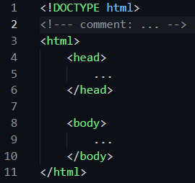
Html basics
Basic html file: tag structure
HTML tags are normally enclosed by angle brackets
Head
Inside <head></head>, to specify the <title> (on the title bar of the browser window)
Also can include <style>, and <script>.
Also can add <meta>, information regarding whole file.
Body
Main content to be shown of the file
The article title
Section head, section text, subsections
Tables, images, etc.
In head can give style to a type of tag (body, h1, h2, etc)
Can have inline style for the specific tag content

Slide 10
Html basics
Class and id
A tag can have class attributes. One tag can have many classes. Also many tag can have same class
A tag can have id attribute. The id must be unique inside the whole file.
Styling to class and id
The styling is not restricted to tags. Better practice is to give style to class, or id
Then in html body, you give class to different tag.
Grouping of many
<div></div> is used to group many tag (sections, text paragraphs), and assign a class to it can style for all of them
Picking part
<span></span> is used to picking up some of the text inline, and assign a class to it can style for only this part of text

Slide 11
Other html tags
Bullet-points
<ul> </ul>for unordered list. <li> for list item
<ol> </ol>for ordered list. <li> for list item
Table
<table></table>
<tr> </tr>, for table row
<td> </td>, for table cell
<th> </th>, make one cell as table header
Image
<img> with src attributes to specify loading image file
Hyperlinks
<a> </a> with href attributes to specify a linking URL

Slide 12
Css
Best practice:
Move styling into a css file.
Html:
for real content
Include the .css files inside <head></head>
<link type="text/css" rel="stylesheet" href=“xxxx.css">

